Slide 1
Review 1.2
B.Tech Project (19ECE495)
Batch ID: 041
Multi-Class Classification and Detection of Knee Osteoarthritis From X- rays
MENTOR: Dr. Devi Vijayan
Dept. of Elec. and Commn. Engg.
Amrita School of Engineering, Coimbatore
CB.EN.U4ECE21008 | - | C RISHI VARDHAN REDDY
CB.EN.U4ECE21011 | - | D M SHAAHID
CB.EN.U4ECE21012 | - | DULAM SANTHOSH
CB.EN.U4ECE21033 | - | NUKALA SUMANTH

Slide 2
Introduction:
A study shows that KOA affects 1 in 5 individuals in the general population and 1 in 3 people over the age of 50. [1]
The early and accurate detection of knee osteoarthritis through advanced AI-driven methods can drastically improve patient outcomes by enabling timely interventions.
Reducing the risk of severe joint damage and enhancing the quality of life for millions of individuals affected by this debilitating condition.
Current methods for diagnosing knee osteoarthritis often misclassify early stages of the disease, leading to delayed or inappropriate treatment.
By developing an automated, accurate grading system, this project provides a reliable tool that can support clinicians in making better-informed decisions, ultimately improving patient care.

Slide 3
Objective:
Develop a Computer-Aided-Diagnosis (CAD) system to assist medical professionals in early and accurate Knee-OA diagnosis.
Utilize deep learning models to automatically classify knee osteoarthritis severity into five grades (G-0 to G-4) according to the Kellgren and Lawrence system.
Implement Grad-CAM to visualize and interpret key regions in knee X-rays that influence the model's predictions, improving transparency and clinical decision-making.
Validate and compare the deep learning model's performance against state-of-the-art models.

Slide 4
Literature :
Sl. # | Title of the paper | Source | Inferences
1 | Development of an automated optimal distance feature-based decision system for diagnosing knee osteoarthritis using segmented X-ray images.[2] | Heliyon, Volume 9, 2023 | Proposes distance-based features and the use of machine learning models in classifying the severity of knee osteoarthritis. Used Grad-Cam to segment Region of Interest. The models were validated by testing it on 30 unseen X-ray images.
2 | Stratifying knee osteoarthritis features through multitask deep hybrid learning: Data from the osteoarthritis initiative[3] | Computer Methods and Programs in Biomedicine, Volume 242, September 2023, Article 107807. | Replaced the fully connected layers in CNNs with Global Average Pooling (GAP) layers for feature extraction, to reduce the number of parameters.

Slide 5
Literature :
Sl. # | Title of the paper | Source | Inferences
3 | Learning From Highly Confident Samples for Automatic Knee Osteoarthritis Severity Assessment: Data From the Osteoarthritis Initiative[4] | IEEE Journal of Biomedical and Health Informaticsvol. 26, no. 3, pp. 1239-1250 | The paper proposes a deep learning method for knee osteoarthritis (OA) severity assessment, using high-confidence samples and a hybrid loss function to enhance accuracy, excelling in both severity grading and early detection.
4 | Knee Osteoarthritis Detection Using an Improved CenterNet With Pixel-Wise Voting Scheme[5] | IEEE Access, vol. 11, pp. 22283-22295, 2023 | The paper proposes a customized CenterNet with DenseNet-201 for improved knee joint localization, achieving over 99% KOA detection accuracy using knowledge distillation to simplify the model.

Slide 6
Literature :
Sl. # | Title of the paper | Source | Inferences
5 | Knee osteoarthritis severity prediction using an attentive multi-scale deep convolutional neural network [6] | Springer link Multimedia Tools and Applications, vol. 83, pp. 6925–6942 | OsteoHRNet is a deep learning model that uses HRNet for multi-scale feature extraction from knee X-rays, with CBAM enhancing relevant feature focus. It optimizes predictions using an ordinal loss function, improving accuracy in classifying osteoarthritis severity.
6 | Evaluating the efficacy of deep learning models for knee osteoarthritis prediction based on Kellgren-Lawrence grading system .[7] | Elsevier e-Prime - Advances in Electrical Engineering, Electronics and Energy, vol. 5, p. 100266 | The study emphasizes the need for accurate, reliable models to automate KOA classification, reducing dependence on radiologists in underserved areas. Increasing dataset size and fine-tuning models could further enhance their clinical effectiveness, improving decision-making.

Slide 7
Literature :
Sl. # | Title of the paper | Source | Inferences
7 | A Sequential VGG16+CNN-Based Automated Approach With Adaptive Input for Efficient Detection of Knee Osteoarthritis Stages[8] | IEEE Access, Vol. 12, 2024, pp. 62407-62415 | By combining the feature extraction power of VGG16 and the spatial analysis capabilities of CNN, the hybrid model significantly improves the accuracy of OA detection from X-ray images
8 | Machine Learning-Based Automatic Classification of Knee Osteoarthritis Severity Using Gait Data and Radiographic Image[9] | IEEE Access, Vol. 8, 2020, pp. 120597-120603 | The integration of both gait data and radiographic images significantly outperforms the use of radiographic images alone for KOA classification in the deep learning model Inception-ResNet-v2.

Slide 8
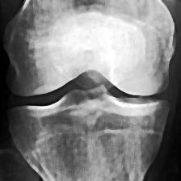
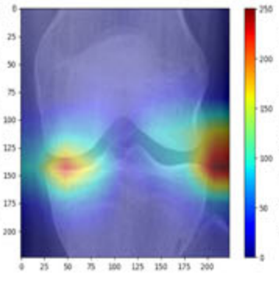
Methodology:
Processed
Input X-ray
Visualization of Extracted Features by Grad-CAM
Predicted
Grade
Grad-CAM
VGG
ResNet
Learned Features
EfficientNet

Slide 9
VGG16:
Layers: VGG16 has 16 weight layers:
1.13 convolutional layers
2. 3 fully connected layers
3. Max-pooling layers after some of the convolutional layers.
VGG16 is commonly used as a pretrained model, meaning it can be fine-tuned for specific tasks such as object detection and image classification.

Slide 10
Evaluation metrics for a classification model:
Performance metrics | Values
Accuracy | 0.8616
Precision | 0.9012
Recall | 0.8616
F1-score | 0.8231
Number of predicted labels: 4017

Slide 11
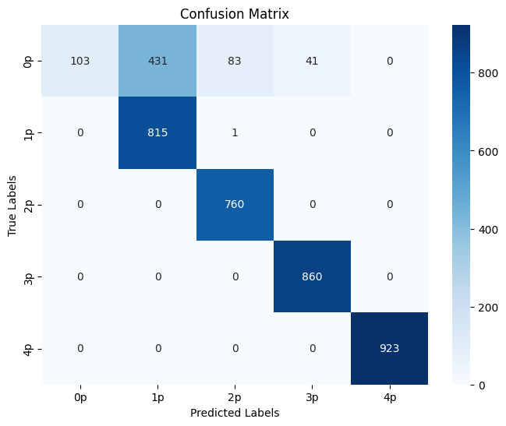
VGG16:
Confusion matrix images :

Slide 12
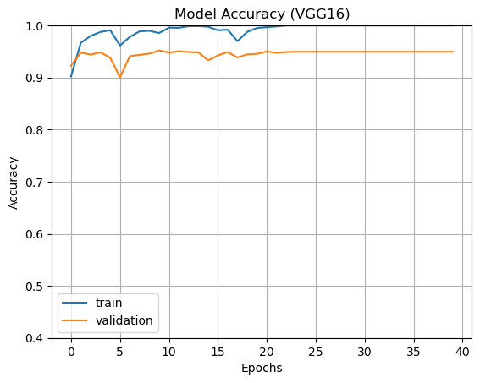
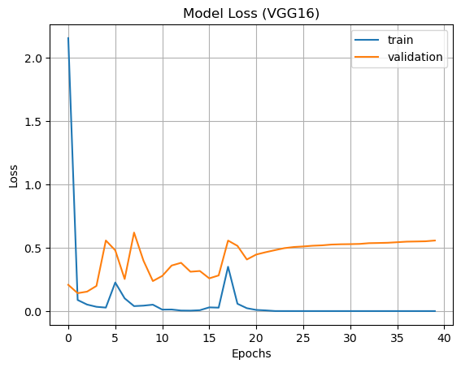
Model accuracy, Loss:

Slide 13
RESNET50:
ResNet-50 was developed by Microsoft Research Asia and released in 2015.
50 layers in total, consisting of:
1 Conv layer (7x7 convolution)
1 Max-pooling layer
16 Residual blocks (each consisting of 3 convolutional layers)
Fully connected (FC) layer
Softmax activation
ResNet-50 is a convolutional neural network (CNN) that excels at image classification.
Feature Hierarchy in ResNet50 are Low-level features and High-level features.

Slide 14
Evaluation metrics for a classification model:
Performance metrics | Values
Accuracy | 0.8382
Precision | 0.9087
Recall | 0.8382
F1-score | 0.7822
Number of predicted labels: 4017

Slide 15
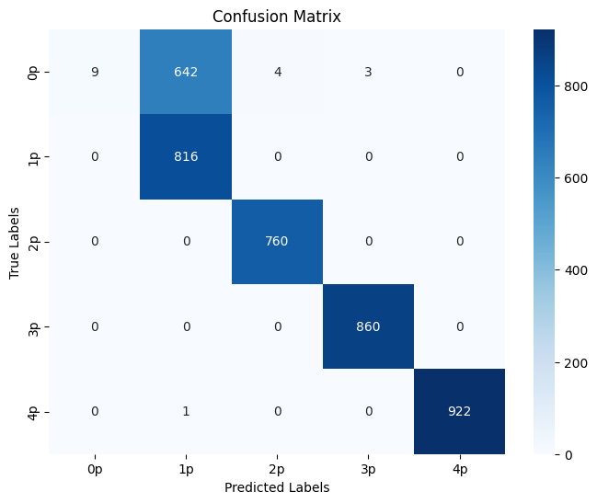
RESNET50:

Slide 16
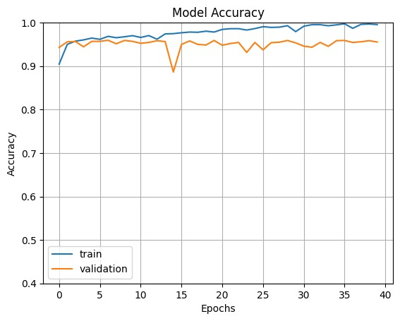
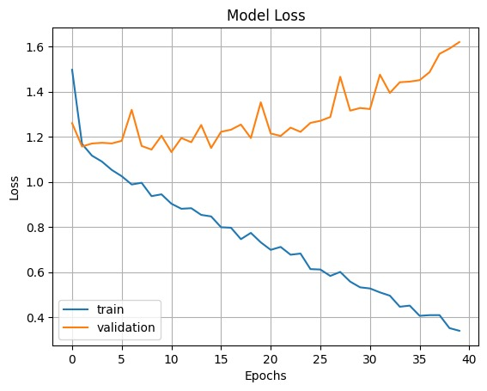
Model accuracy, Loss:

Slide 17
EfficientNetV2B0
EfficientNet, introduced by Google AI researchers in 2019, excels in tasks like object detection and image segmentation.
It employs compound scaling to optimize model dimensions—width, depth, and resolution.
The architecture achieves efficiency without compromising accuracy, overcoming traditional accuracy-resource trade-offs.
The EfficientNetV2B0 architecture consists of 9 layers in total. These layers include, Conv2D Layers, Batch Normalization Layers, Depthwise Separable Convolution Layers, Global Average Pooling Layer.

Slide 18
Evaluation metrics for a classification model:
Performance metrics | Values
Accuracy | 0.8708
Precision | 0.8881
Recall | 0.8708
F1-score | 0.8486
Number of predicted labels: 4017

Slide 19
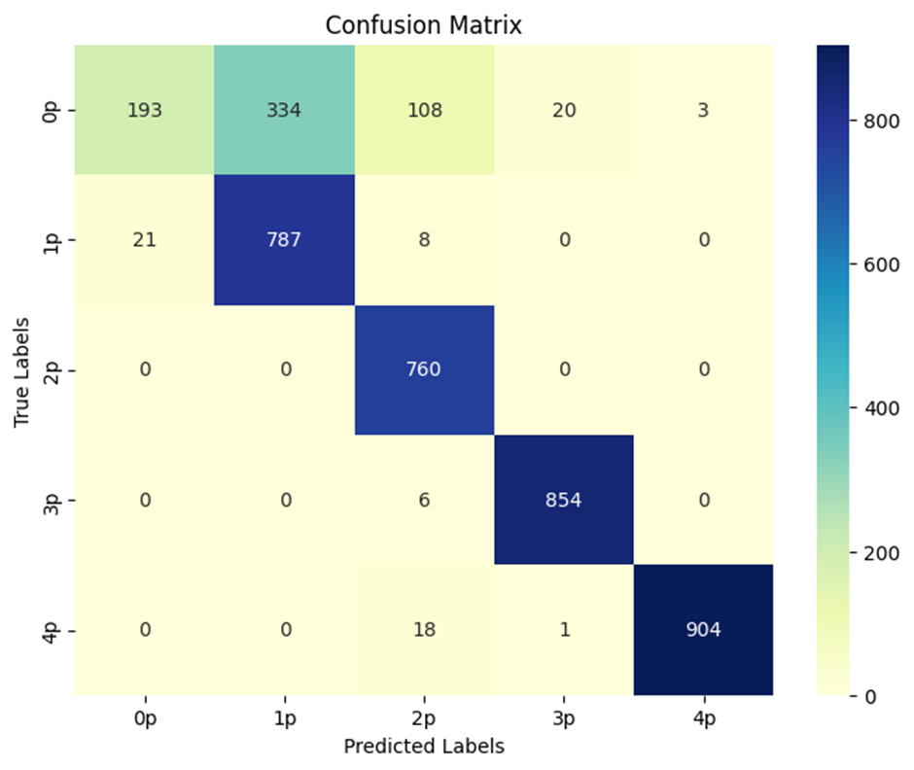
EfficientNetV2B0:

Slide 20
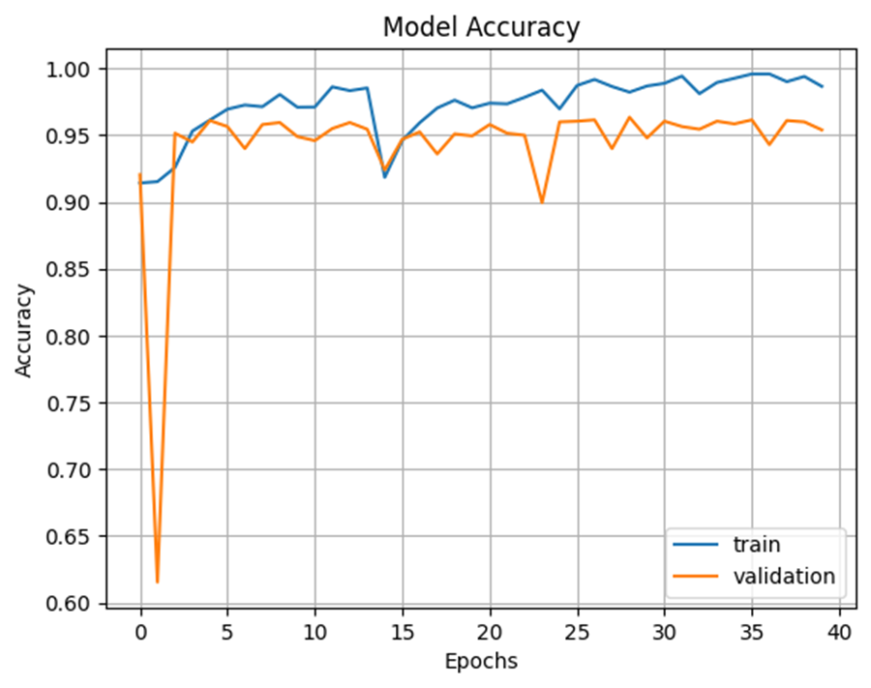
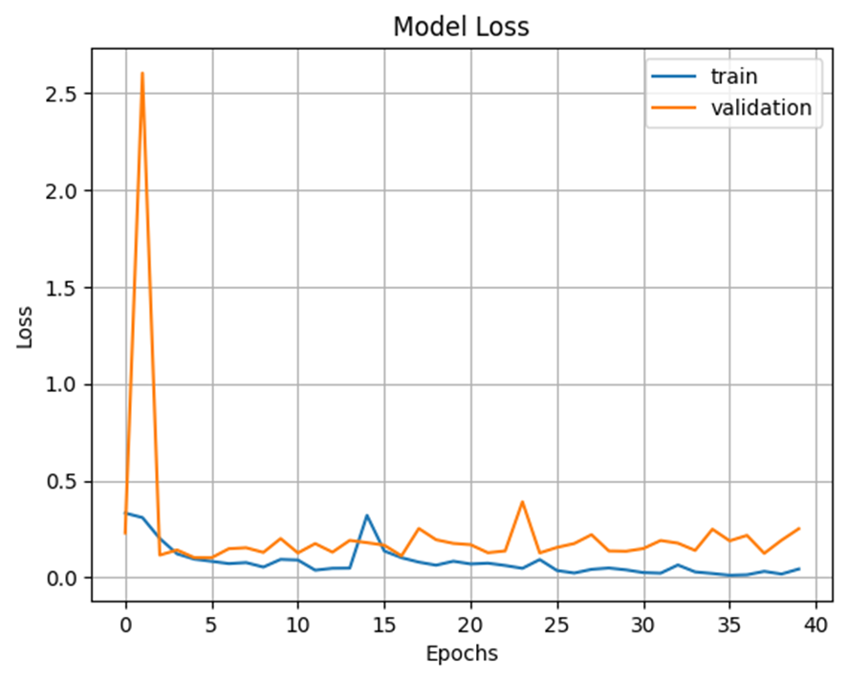
Model accuracy, Loss:

Slide 21
Timeline:
Review | Month | Milestone
1.1 | Aug 2024 | Data preparation, Data Preprocessing, Literature survey
1.2 | Sep 2024 | Literature survey, Analysis of state-of-the-art models
1.3 | Nov 2024 | Building of classification model
2.1 | Jan 2025 | Validation and performance comparison, Paper draft
2.2 | Mar 2025 | Paper Draft
2.3 | May 2025 (External Review) | Project Report / Dissertation

Slide 22
Deliverables:
The State-of-the-art models are trained on the pre-processed data set.
The state of the models are evaluated using performance metrics.
Further literature survey has been conducted.

Slide 23
Summary:
Early Detection of KOA: Detecting knee osteoarthritis (KOA) at early stages and starting treatment is beneficial for patients.
Evaluated 3 state of the art models on pre-processed data set.
Achieved a high training data accuracy and low training loss.
The Validation data accuracy achieved for VGG16 - 86.16%, ResNet50 – 83.82%, and EfficientNetV2B0 - 87.08% .

Slide 24
References:
A. Mobasheri, C. S. Thudium, A.-C. Bay-Jensen, T. Maleitzke, S. Geissler, G. N. Duda, and T. Winkler, "Biomarkers for osteoarthritis: Current status and future prospects," Best Practice & Research Clinical Rheumatology, vol. 37, p. 101852, June 2023
K. Fatema, M. A. H. Rony, S. Azam, M. S. H. Mukta, A. Karim, M. Z. Hasan, and M. Jonkman, "Development of an automated optimal distance feature-based decision system for diagnosing knee osteoarthritis using segmented X-ray images," Heliyon, vol. 9, e21703, 2023.
Y. X. Teoh, A. Othmani, K. W. Lai, and S. L. Goh, "Stratifying knee osteoarthritis features through multitask deep hybrid learning: Data from the osteoarthritis initiative," Computer Methods and Programs in Biomedicine, vol. 242, p. 107807, Sep. 2023.
Y. Wang, Z. Bi, Y. Xie, T. Wu, X. Zeng, S. Chen, and D. Zhou, "Learning From Highly Confident Samples for Automatic Knee Osteoarthritis Severity Assessment: Data From the Osteoarthritis Initiative," IEEE Journal of Biomedical and Health Informatics, vol. 26, no. 3, pp. 1239-1250, Mar. 2022.
S. Aladhadh and R. Mahum, "Knee Osteoarthritis Detection Using an Improved CenterNet With Pixel-Wise Voting Scheme," IEEE Access, vol. 11, pp. 22283-22295, 2023.

Slide 25
Methodology:
Dataset
Total 10000 images
2000 (Grade 0 ) Images
Train 8000 images
Validation 2000 images
PREPROCESSING
2000 (Grade 1 ) Images
Quantum Noise Reduction
ResNet
Grad CAM
Augmentation
2000 (Grade 2 ) Images
Feature Extraction
Histogram Equalization
2000 (Grade 3 ) Images
Convolutional Block Attention Module(CBAM)
2000 (Grade 4 ) Images
Unsharp Masking
SVM
Machine learning
classifier
Test Dataset
(To be given after
Training model)
Output Prediction

Slide 26
Grad CAM
Feature Extraction
ResNet
Test Dataset
(To be given after
Training model)
Convolutional Block Attention Module(CBAM)
SVM
Machine learning
classifier
Output Prediction

Slide 27
References:
R. K. Jain, P. K. Sharma, S. Gaj, A. Sur, and P. Ghosh, "Knee osteoarthritis severity prediction using an attentive multi-scale deep convolutional neural network," Multimedia Tools and Applications, vol. 83, pp. 6925–6942, June 2023.
V. K. Vijaya, V. Kalpana, and G. H. Kumar, "Evaluating the efficacy of deep learning models for knee osteoarthritis prediction based on Kellgren-Lawrence grading system," e-Prime - Advances in Electrical Engineering, Electronics and Energy, vol. 5, p. 100266, Aug. 2023.
A. S. C. Bose, C. Srinivasan, and I. J. S., "Optimized feature selection for enhanced accuracy in knee osteoarthritis detection and severity classification with machine learning," Biomed. Signal Process. Control, vol. 97, pp. 106670, Aug. 2024.
M. U. Farooq, Z. Ullah, A. Khan, and J. Gwak, "DC-AAE: Dual channel adversarial autoencoder with multitask learning for KL-grade classification in knee radiographs," Computers in Biology and Medicine, vol. 167, pp. 107570, 2023.

Slide 28
Thank You

